Slide 1
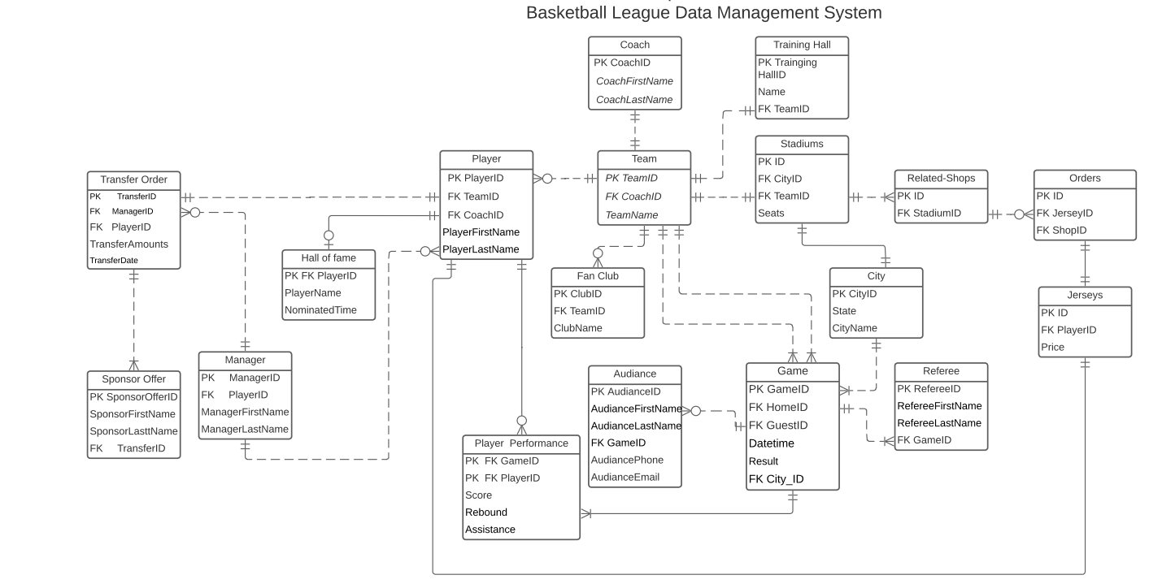

Slide 2
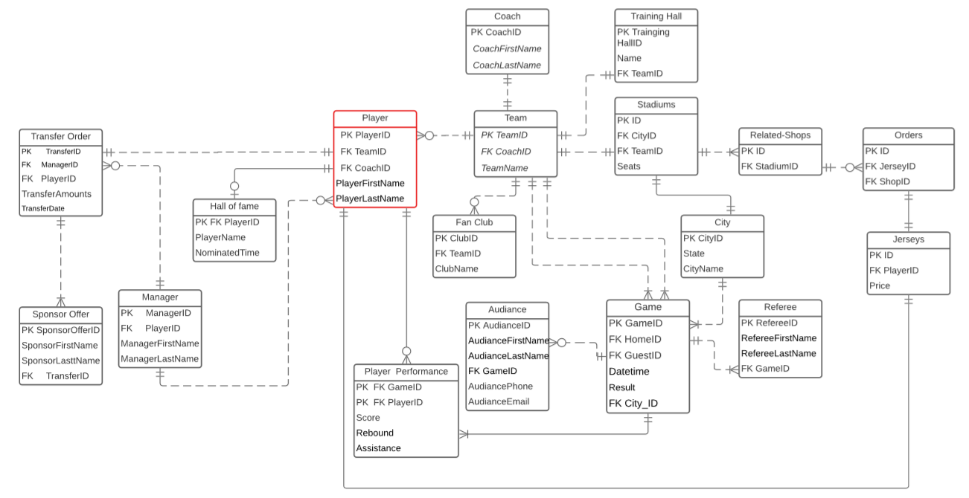
Player
The player entity is directly closely connected to the team, player performance, Jerseys, hall of fame, manager, and transfer order.
—The relationship between player and transfer order is
one-to-one.
—The relationship between player and performance is
one-to-many.

Slide 3
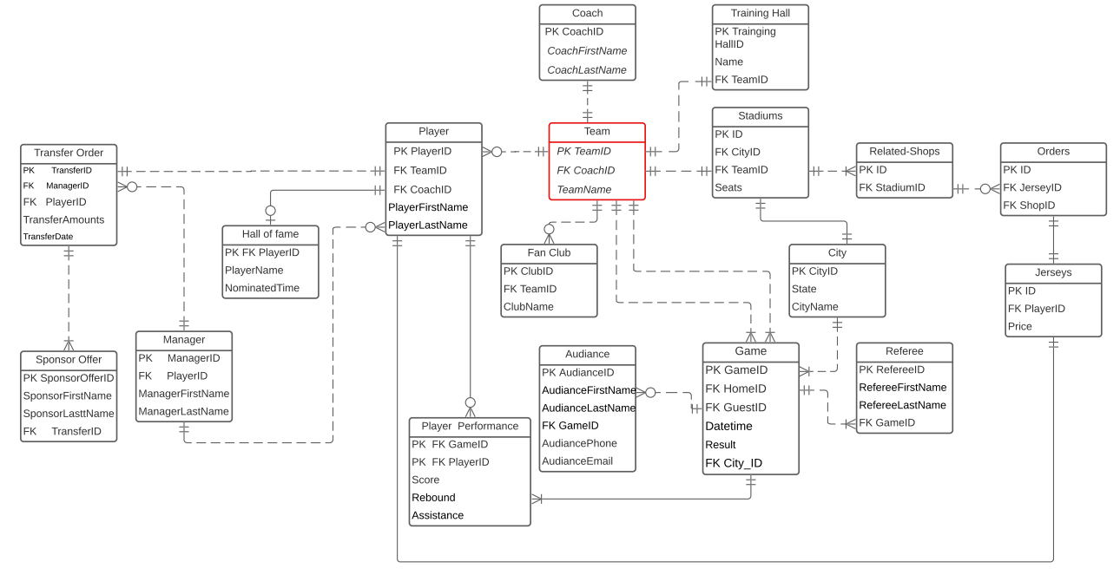
Team
The team entity is directly related to the coach, training hall, stadiums.
—The relationship between coach, training hall, stadiums is one-to-one.
—The relationship between team and player, fan club, game is
one-to-many.

Slide 4
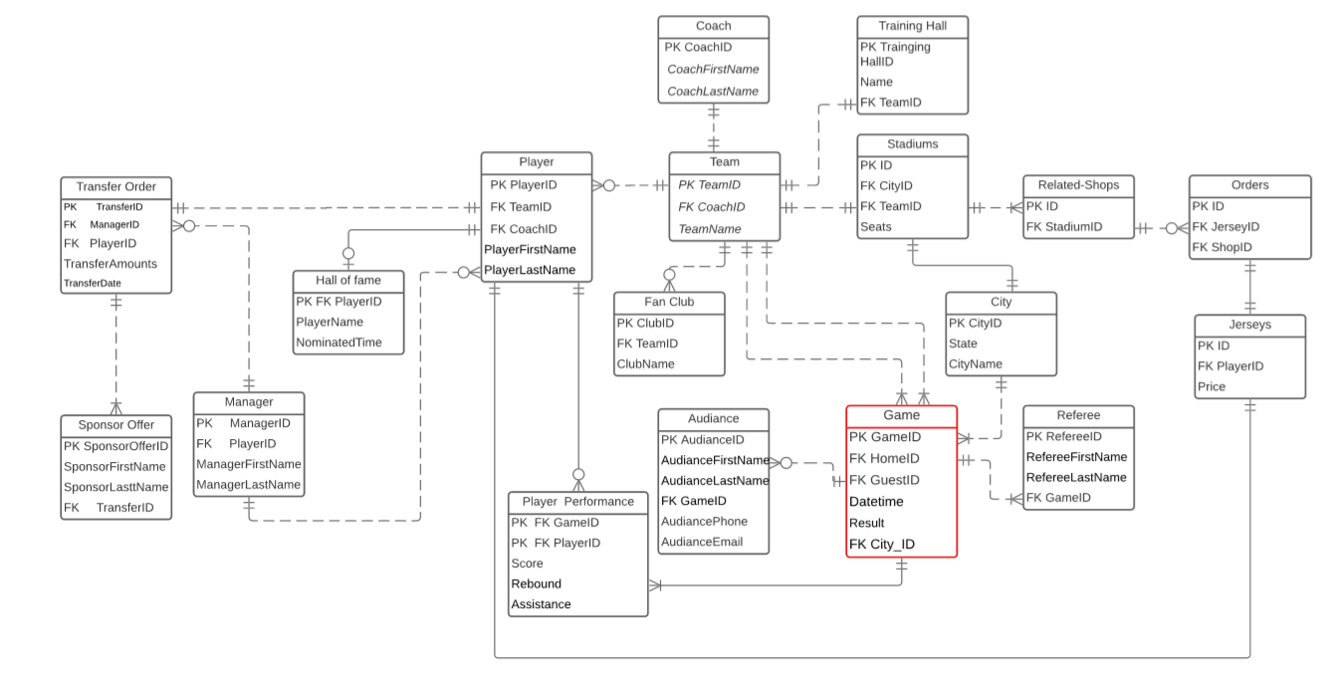
Game
The game entity is used to collect information about each game.
— The relationship between team, city and game is one to many.
— The relationship between game and referee, referee, and player performance is one to many.

Slide 5
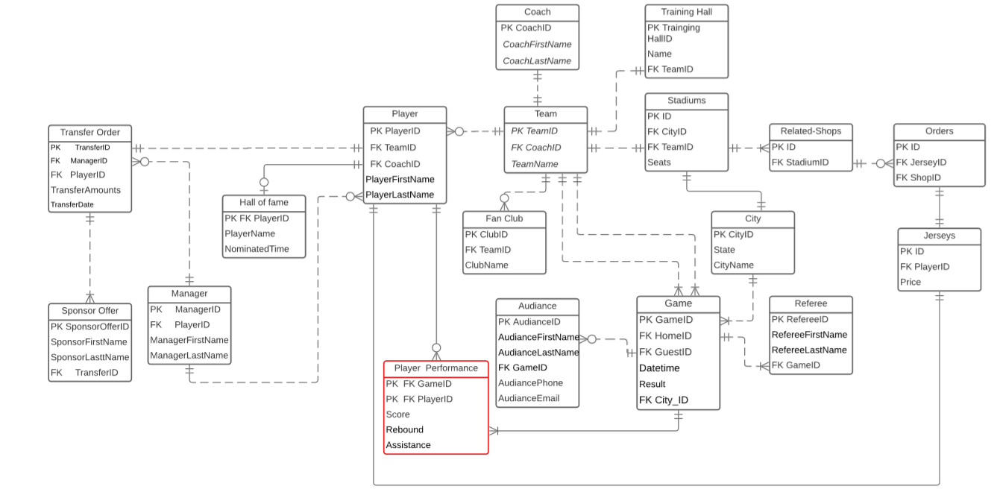
Player Performance
To hold the data that shows the player's score, rebound and assistance number in a game.
— The Relationship between player and player performance is one to many.
— The Relationship between game and player performance is also one to many.

